Slide 1
Working of Git
By velocity

Slide 2
Create a Local Repository
By default, Git software doesn’t track each and every file on your computer. We’ve to inform Git about the specific folder that it must track.
To do so, open your command prompt or terminal inside the specific folder and execute the below command.
git init

Slide 3
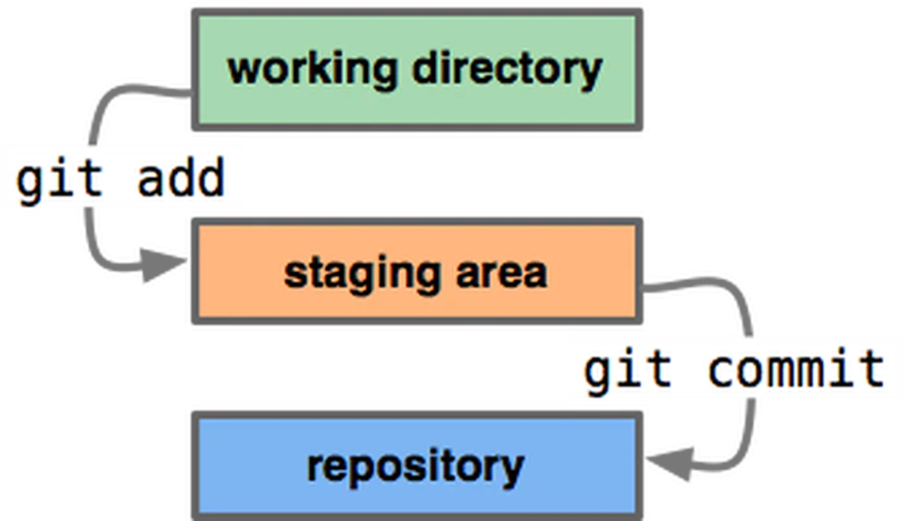
The Git workflow is divided into three states:

Slide 4
1.Working Directory [Eclipse is your working directory]
-It simply refers to the current state of files and folders inside your file system. You can Modify files in your working directory. At this point, Git doesn’t track these files.

Slide 5
2.Staging Area
Before saving any file to a local repository, you have to place it in a staging area. It’s like a temporary location for your files and folders before commit. You can easily add or remove files from a staging area.
If you’ve modified any files and you want to add them in a staging area then simply execute the below command.
Adding files to git
Check status
Git allows you to easily check which files are tracked/un-tracked inside a staging area. To do so, you can use the below command.
git add .
git add demo.java
git status

Slide 6
3.Git directory (Repository)
A git directory holds your actual committed files. Git stores all this information inside a hidden folder called .git, When you commit something, whatever inside your staging area is permanently saved in a repository.
How to commit file
git commit -m “commit message”

Slide 7
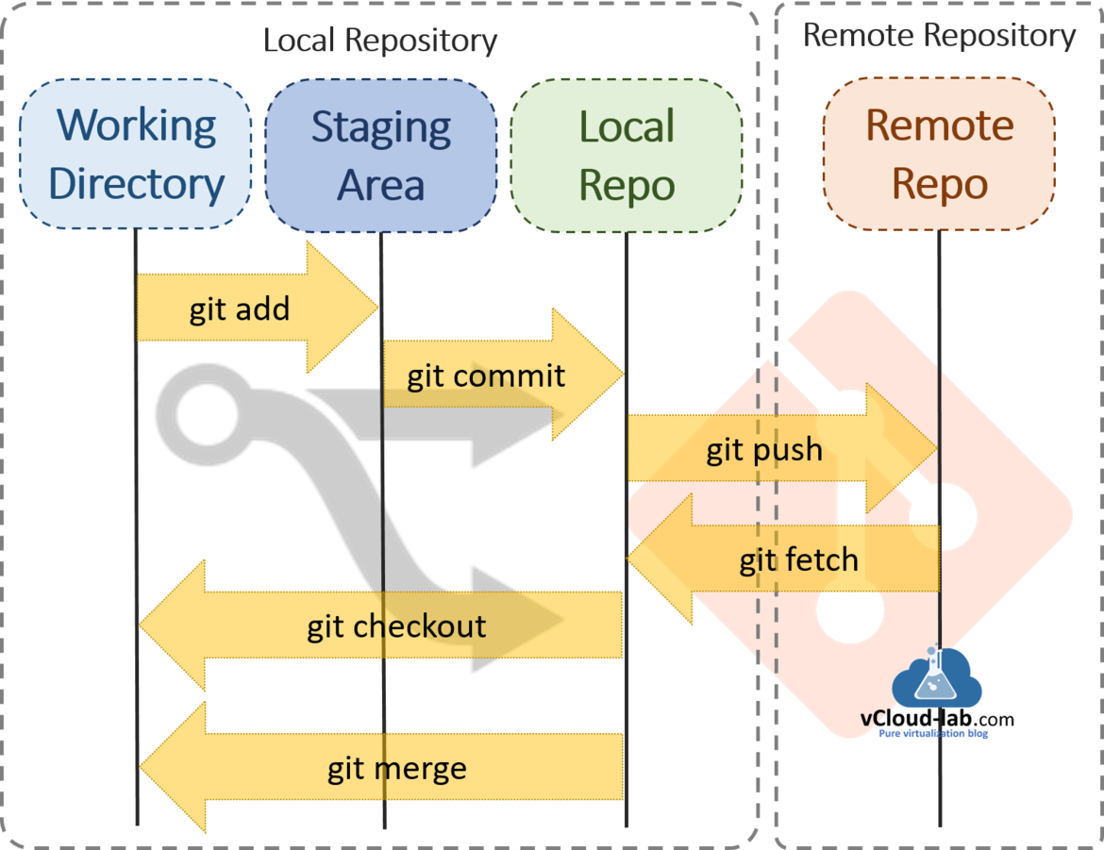

Slide 8
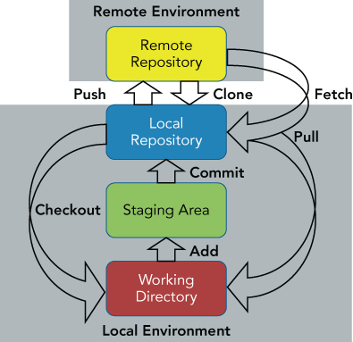

Slide 9

Lets Do practical's….

